Slide 1

Event Driven CI/CD Pipelines
Enable Asynchronous CD without Skynet happening
Brett Smith
xbcsmith@gmail.com

Slide 2
The Software Supply Chain

Slide 3
The pipeline produces…
Packages
RPMS
DPKG
OCI Images
Architectures
x86_64
aarch64
ppc64le
Deployments
Bare Metal
VMs
Kubernetes
*msi and msm packages as well

Slide 4
The pipeline before CI/CD Events

Slide 5
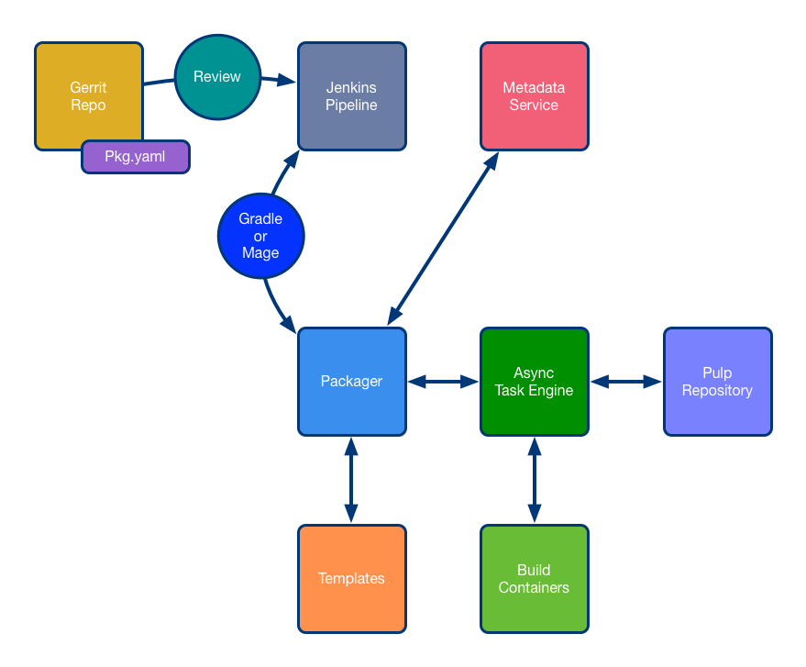

Slide 6
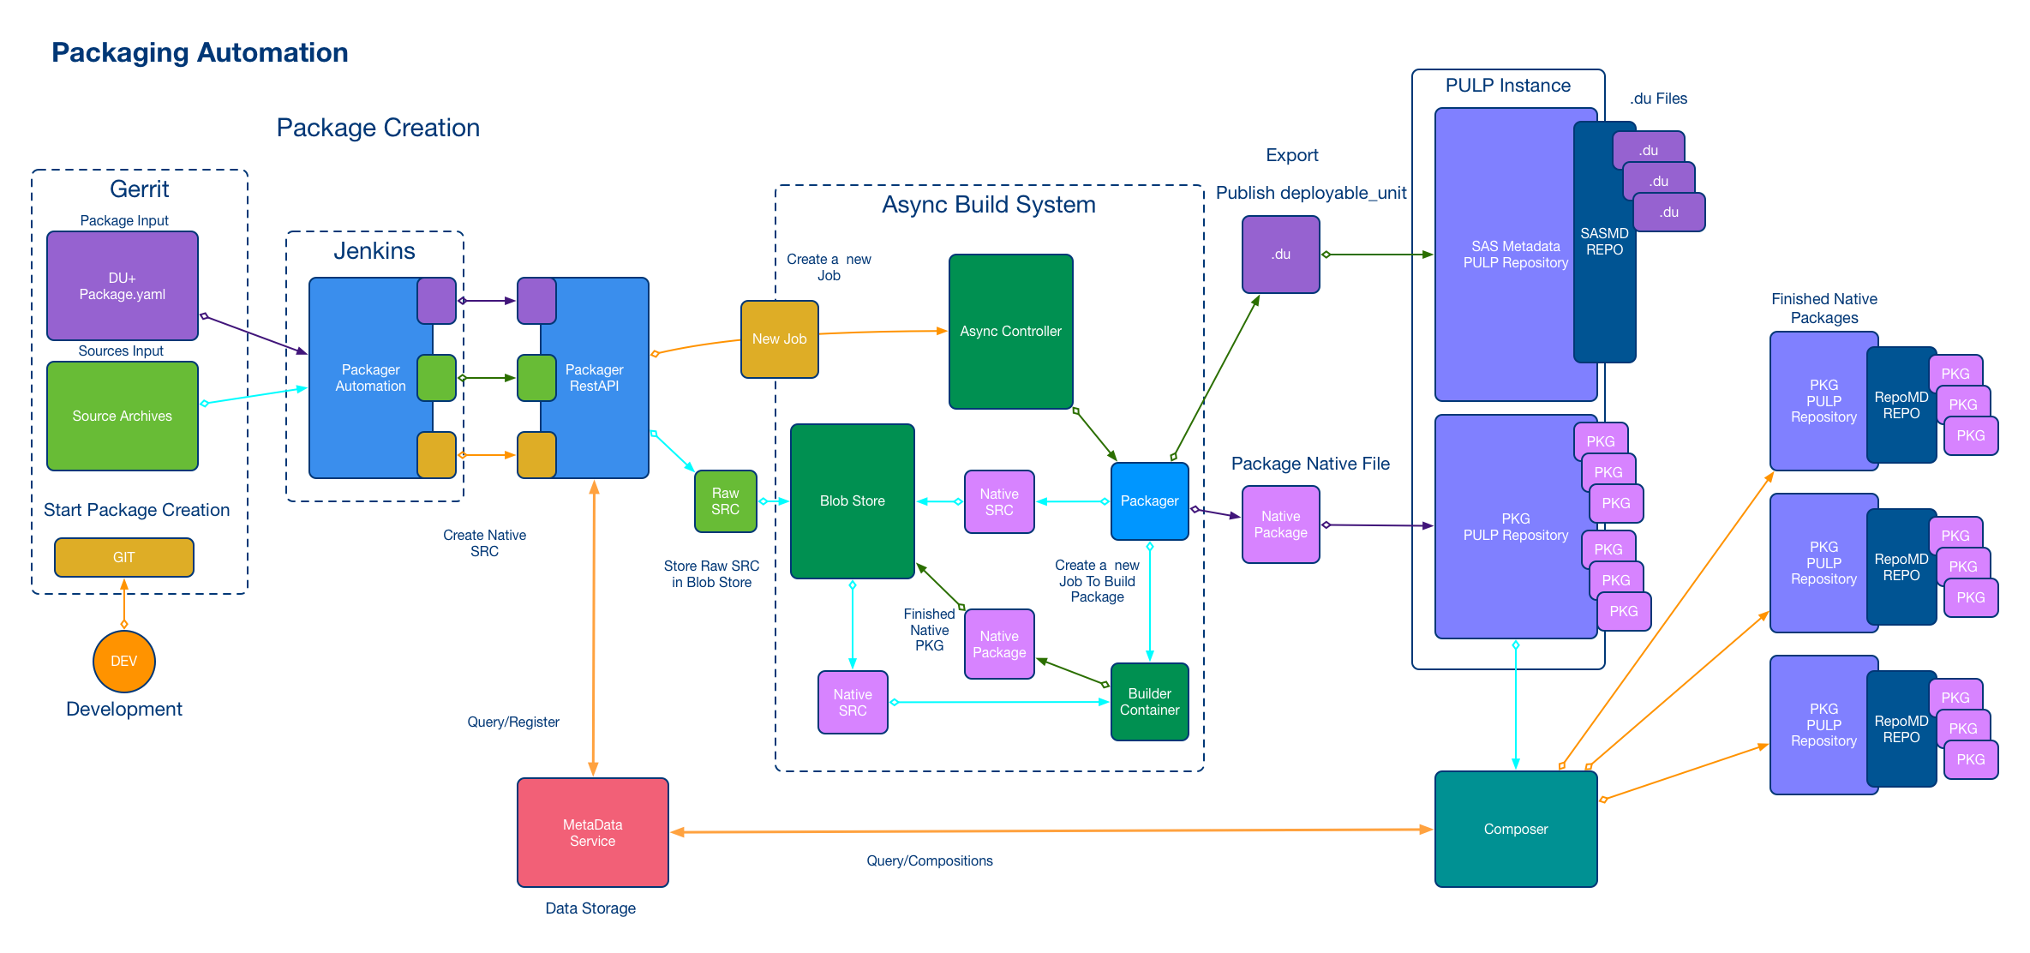

Slide 7
Why Event Driven CI/CD?

Slide 8
The Audit Trail and Gating
Actions
Receipts
Gates
Stages

Slide 9
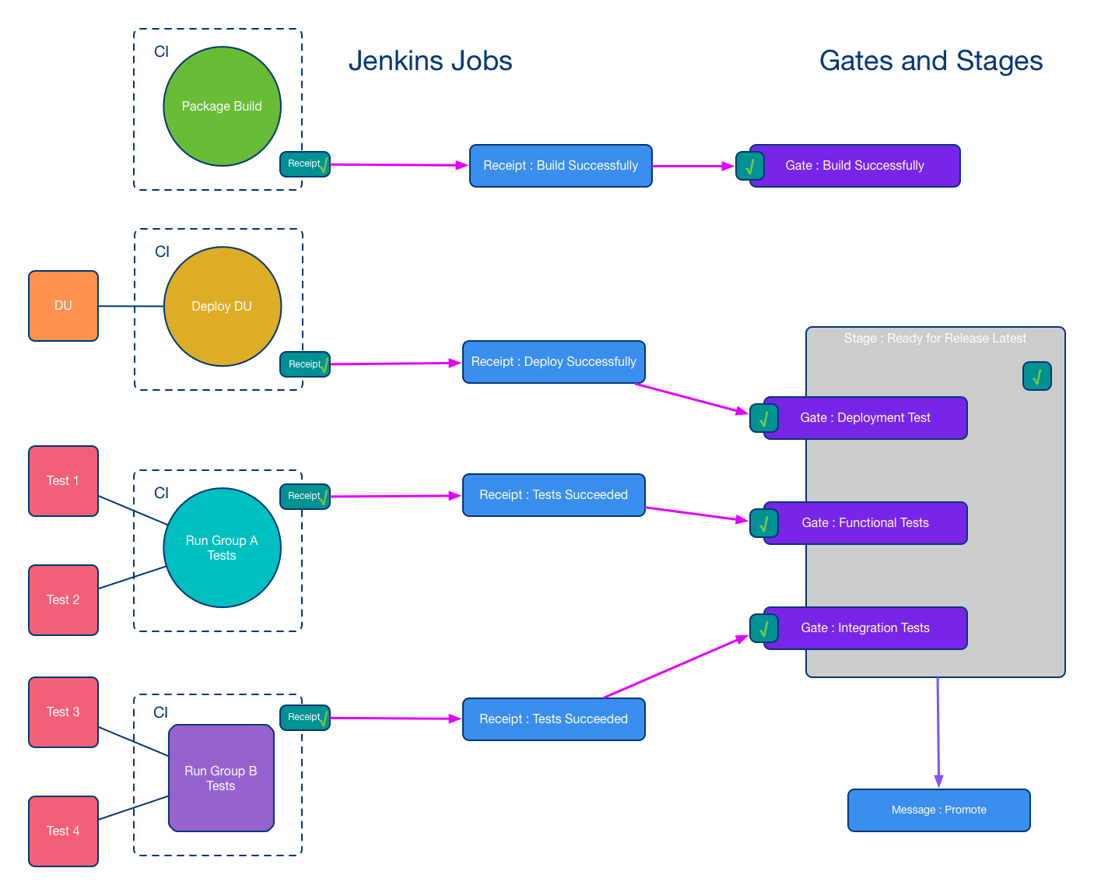

Slide 10
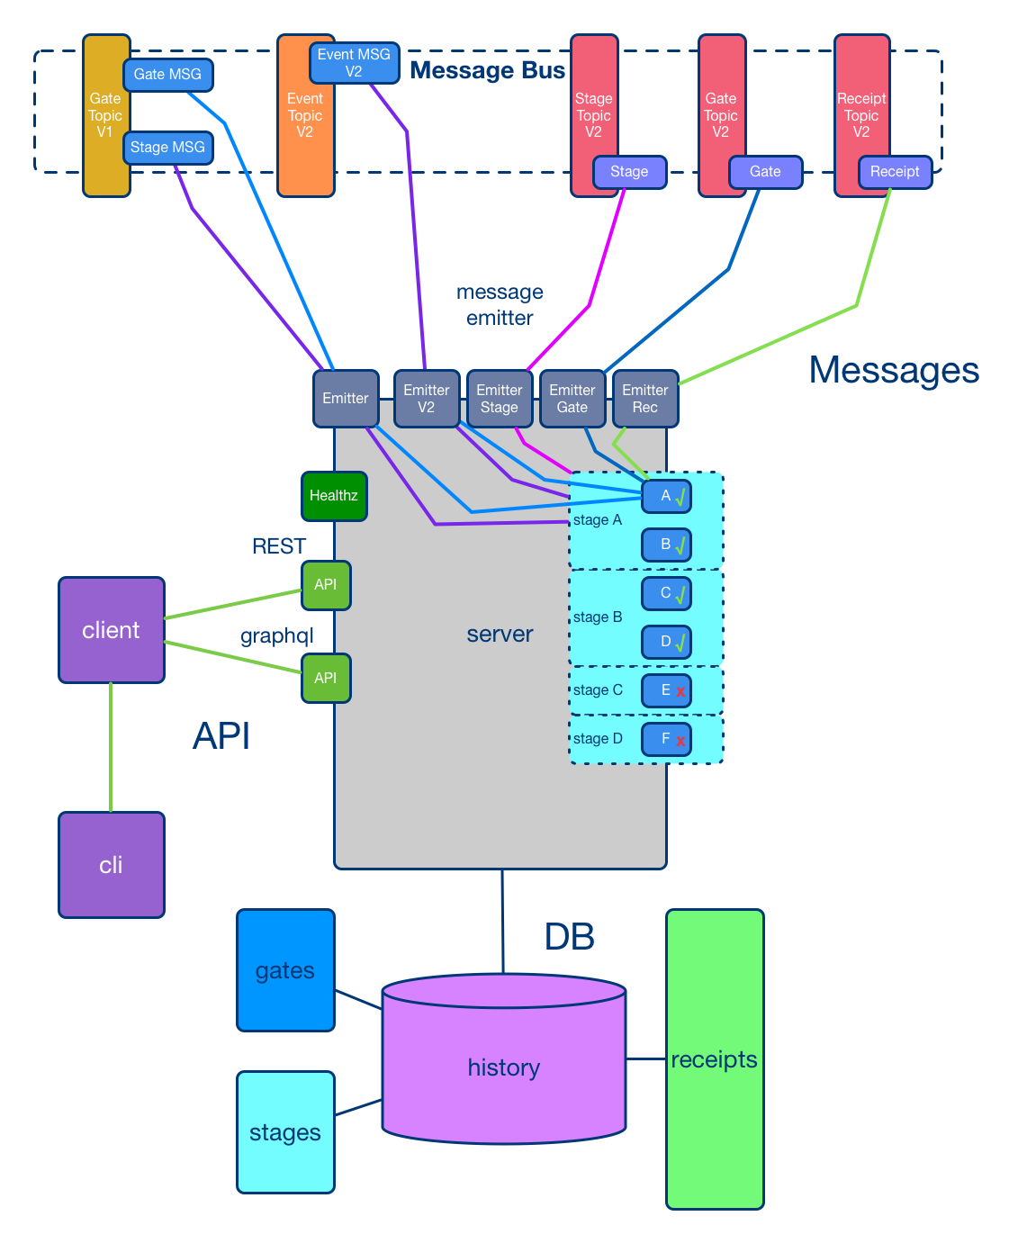

Slide 11
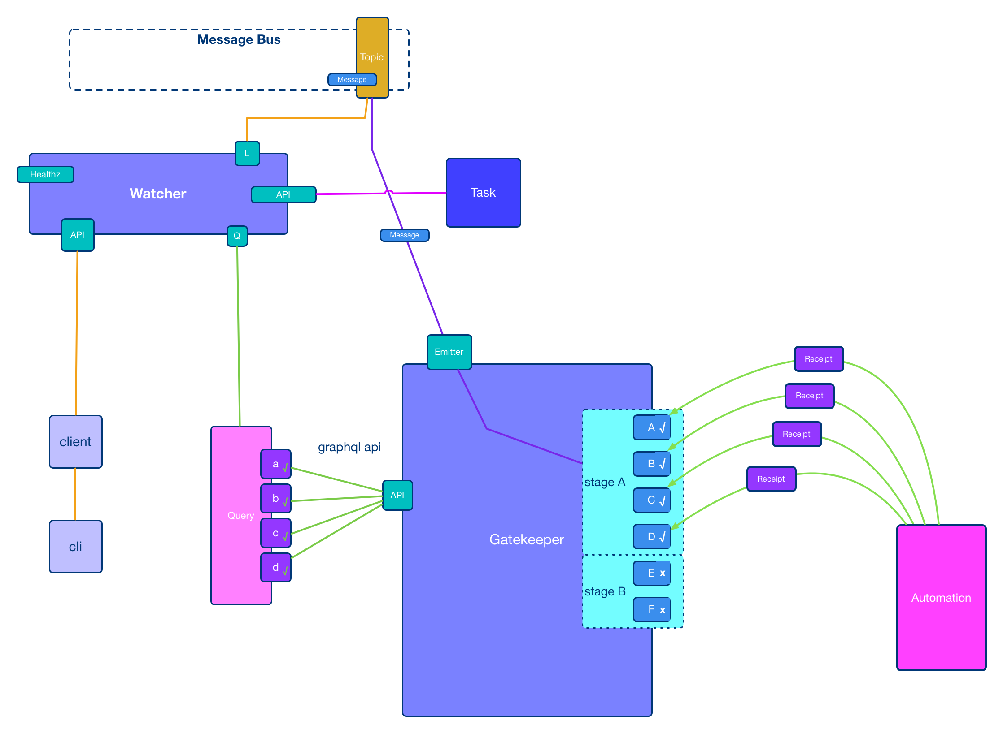

Slide 12
The pipeline after CI/CD Events

Slide 13
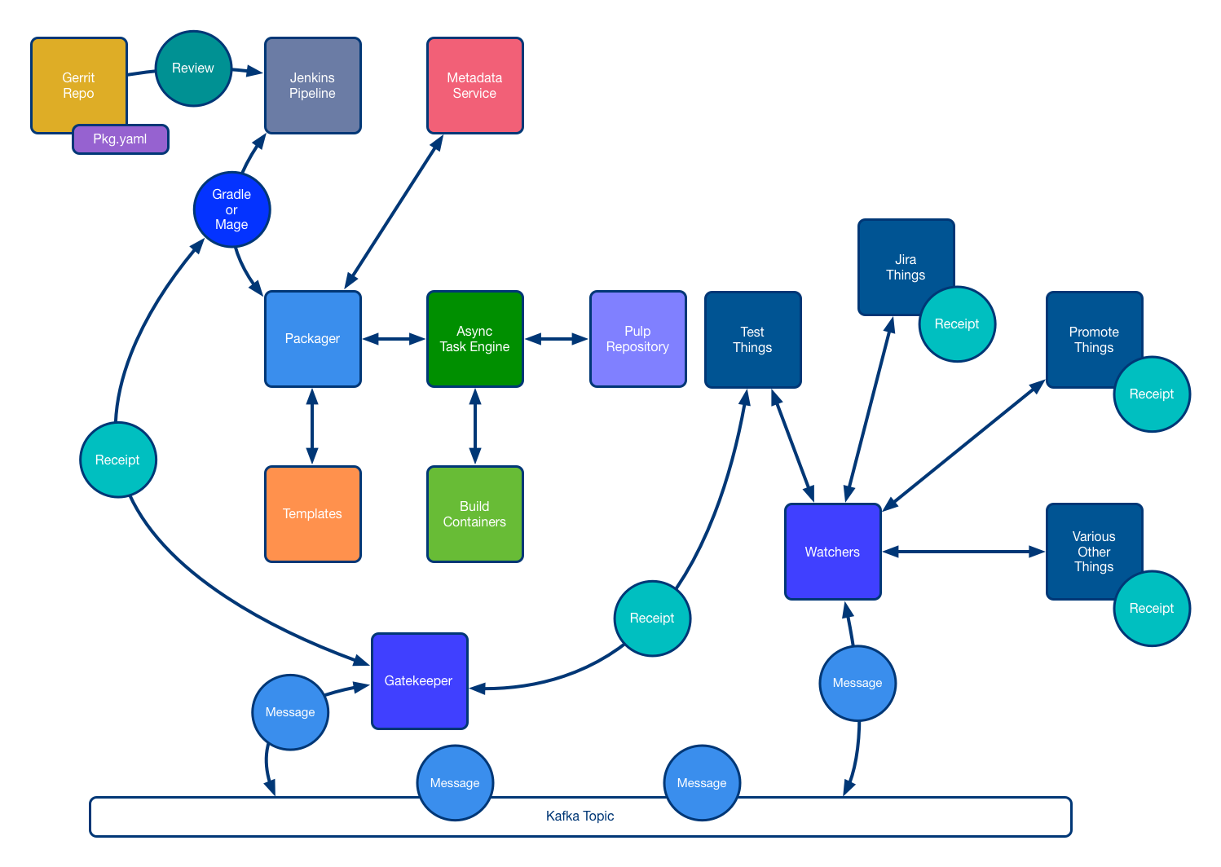

Slide 14
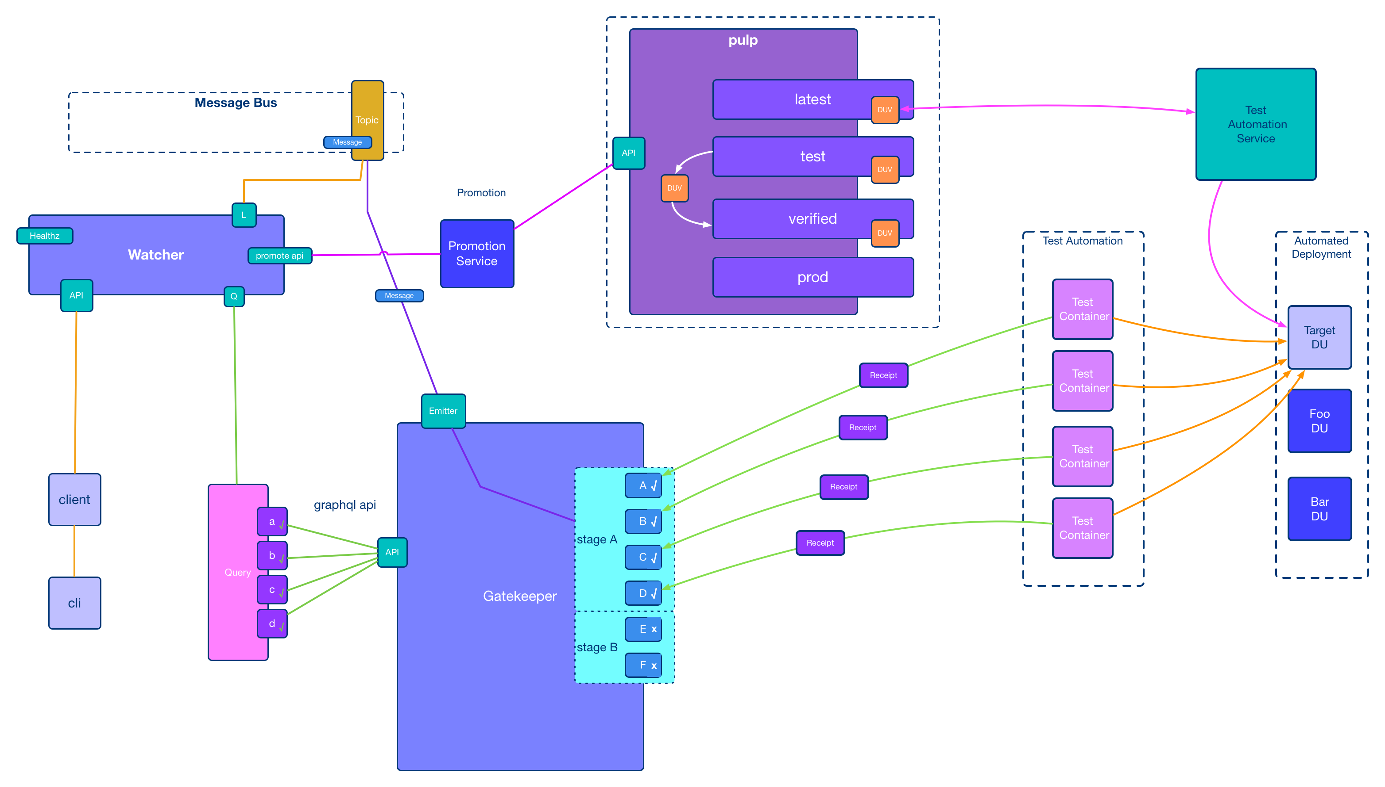

Slide 15
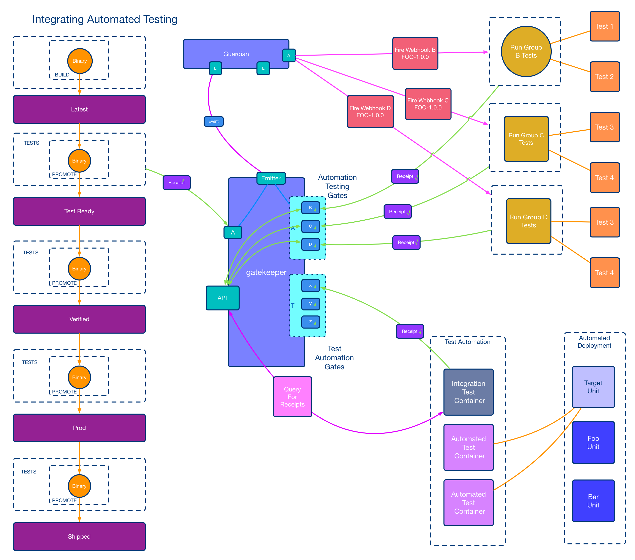

Slide 16
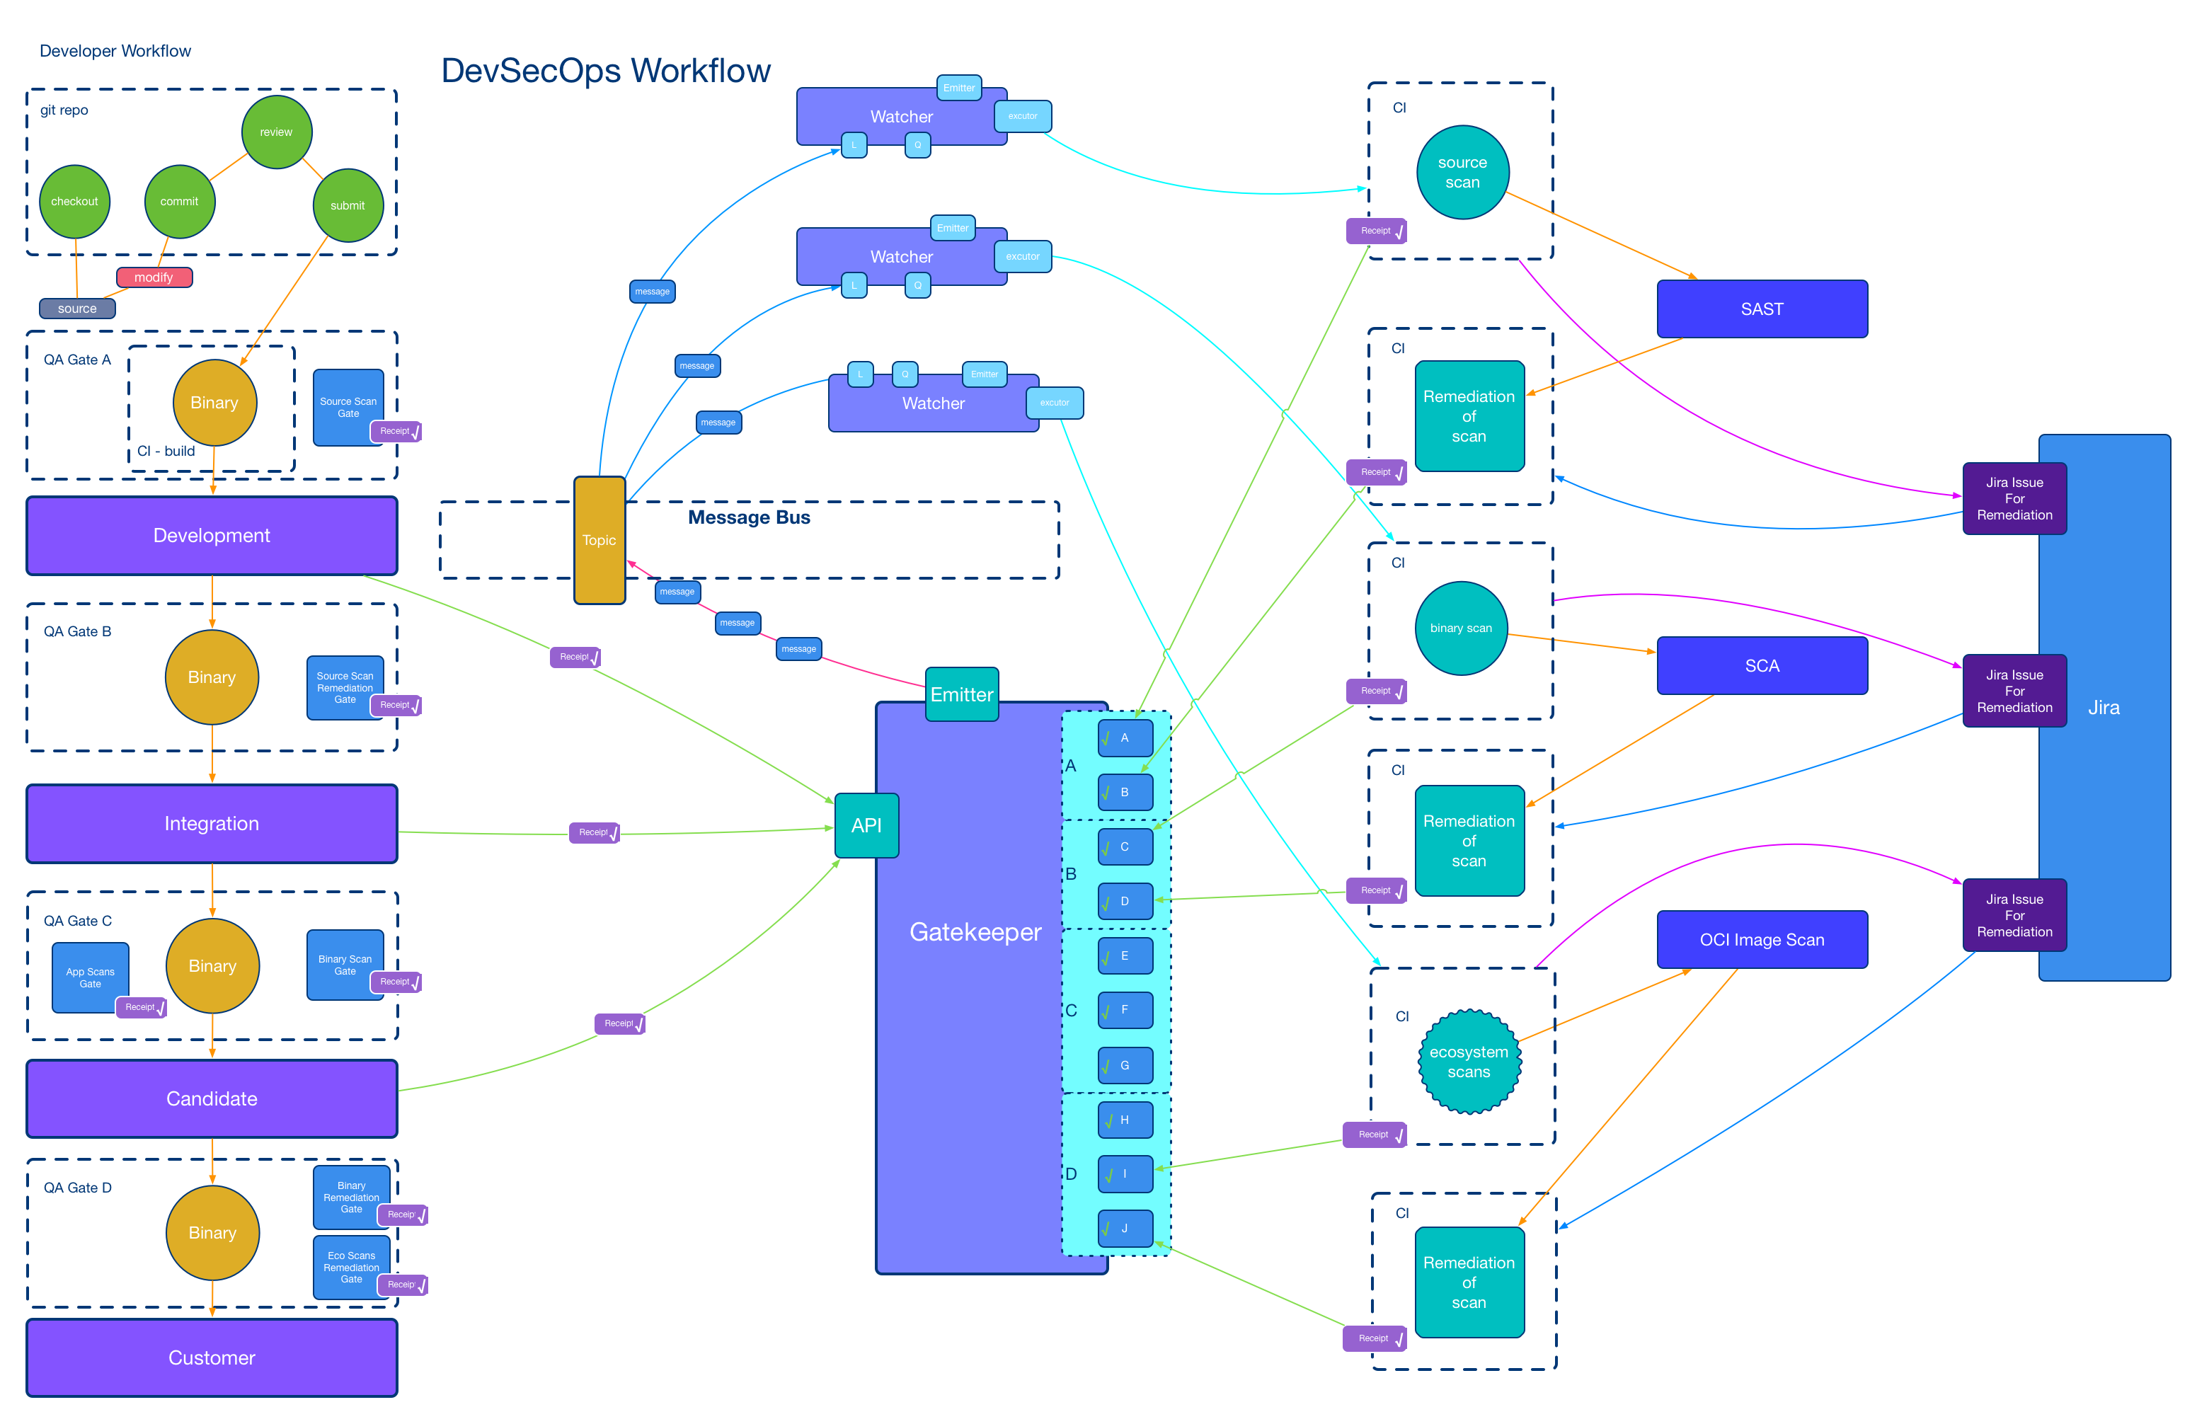

Slide 17
Lessons Learned
JSON Schema
Xunit Schema
Authentication (OIDC)
Event Message Size
Watcher SDK
CNAB
Observability

Slide 18
Had we only…
Cryptographic Signing of Receipts
RBAC Service
Observability

Slide 19
CD Foundation
CDFoundation
https://cd.foundation
cdevents - A common specification for Continuous Delivery events
https://cdevents.dev
SIG Events
https://github.com/cdfoundation/sig-events
SIG Software Supply Chain
https://github.com/cdfoundation/sig-software-supply-chain

Slide 20
Hope is not a strategy (truth)
Electric Sheep harmed (0)
Receipts, Gates, Stages (done)
Everything gets a receipt (mostly done)
Robots promote the units (done)
Letter to Deckard (written)
Automatic not just Automated (mostly done)
Reproduce actions from Receipts (not quite how I wanted but close)
Trace the lifecycle of a binary and how it got there (done)
Machine learning to Optimize (not yet)
Predictive test selection (not yet)
Deployment Risk Prediction (not yet)
Afraid of robots (true)

Slide 21
I am Smitty and I am afraid of Robots
Brett Smith
xbcsmith@gmail.com

